Slide 2
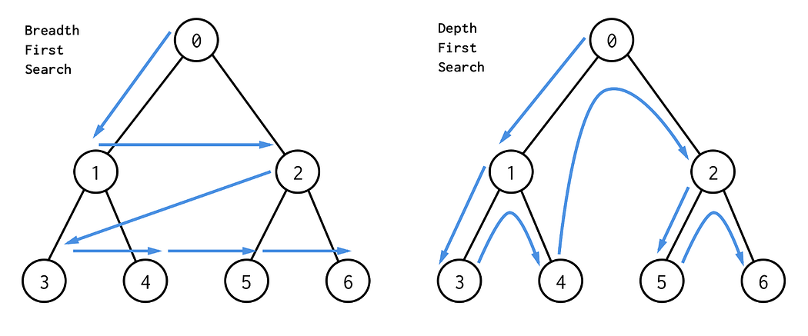

Slide 3
queue
head
link 0
tree node 0
next

Slide 4
pop(queue)
queue
head
tree node 1
left
tree node 0
right
tree node 2

Slide 5
push(queue,node1)
push(queue,node2)
queue
head
link 0
tree node 1
link 1
tree node 2
next

Slide 6
tree node 3
left
queue
head
tree node 1
right
tree node 4
link 1
tree node 2
next

Slide 7
tree node 3
queue
head
tree node 4
link 1
tree node 2
next

Slide 8
push(queue,node1)
queue
head
push(queue,node2)
link 1
tree node 2
link 2
tree node 3
link 3
tree node 4
next

Slide 9
pop(queue)
tree node 5
left
queue
head
tree node 2
right
tree node 6
link 2
tree node 3
link 3
tree node 4
next

Slide 10
push(queue,node5)
queue
head
push(queue,node6)
link 2
tree node 3
link 3
tree node 4
link 4
tree node 5
link 5
tree node 6
next

Slide 11
pop(queue)
null
queue
head
left
tree node 3
link 3
tree node 4
right
null
link 4
tree node 5
link 5
tree node 6
next

Slide 12
pop(queue)
null
queue
head
left
tree node 4
link 4
tree node 5
right
null
link 5
tree node 6
next

Slide 13
pop(queue)
null
queue
head
left
tree node 5
link 5
tree node 6
right
null
next

Slide 14
pop(queue)
null
queue
head
left
tree node 6
next
right
null

